Slide 1
Academic Success A Dive Into Effects on the Success of K-12 US Public Schools
Paper Straws.LLC

Slide 2

Motivation and Scope
NFL → Education???
Team interests
Gaming findings
Numerous and robust data sources
Is student performance* affected by the following variables selected for study by the Paper Straws team?
Student:teacher ratio
School financials
State of residence
*”Student performance” defined as: math scores, science scores, High School graduation rate

Slide 3
Key Findings
Student:teacher ratio finding
School financials finding
State of residence finding
Describe the core message or hypothesis for your project.
Describe the questions you and your group found interesting, and what motivated you to answer them
Summarize where and how you found the data you used to answer these questions
Describe the data exploration and cleanup process (accompanied by your Jupyter Notebook)
Describe the analysis process (accompanied by your Jupyter Notebook)
Summarize your conclusions. This should include a numerical summary (i.e., what data did your analysis yield), as well as visualizations of that summary (plots of the final analysis data)
Discuss the implications of your findings. This is where you get to have an open-ended discussion about what your findings "mean".
*”Student performance” defined as: math scores, science scores, High School graduation rate

Slide 4
Generic Graph/Information

Slide 5
Question and Motivation
Step 1 Title
Task description
Task description
Task description
Task description
Step 2 Title
Task description
Task description
Task description
Step 3 Title
Task description
Task description
Step 4 Title
Task description
Task description

Slide 6
Contextual Facts
First bullet point here
Second bullet point here
Third bullet point here
Class | Group 1 | Group 2
Class 1 | 82 | 95
Class 2 | 76 | 88
Class 3 | 84 | 90

Slide 7
Datasets and Locations

Slide 8
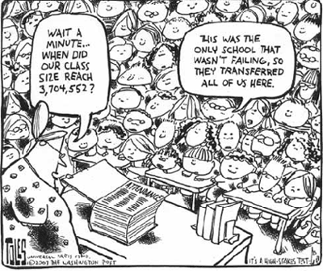
Data Wrangling, Clean-up, and Explanation

Slide 9
Clean Up

Slide 10

Analysis

Slide 11
Analysis

Slide 12
Conclusions and Implications

Slide 13
Conclusion

Slide 14
Graphs and Visualizations

Slide 15
Implications

Slide 17
Citations

